Slide 1
HealthConnect
Week 8 Final Data Analytics Presentation
Final Analytics, Dashboard & Business Insights
HealthConnect Clinic Experience Lab
By AJIBOLA AYOBAMI
Data Analytics Track
1

Slide 2
Project Objective
• Analyse appointment attendance and no-show behaviour using the HealthConnect appointment dataset.
• Identify patterns associated with missed appointments and validate the most important findings.
• Build an interactive Power BI dashboard for KPI monitoring and decision support.
• Translate validated analytical findings into practical business recommendations.
2

Slide 3
Final Dataset & KPIs
5,000 appointment records analysed
5,000
2,423
48.46%
46.3%
TOTAL APPOINTMENTS
NO-SHOW COUNT
NO-SHOW RATE
ATTENDANCE RATE
5.3%
CANCELLATION RATE
• Key variables included outcome, previous no-shows, reminders, appointment type, age group, booking lead time, distance and waiting time.
• The final KPI values were validated against the underlying dataset during Week 7.
3

Slide 4
Key Analytical Finding
Previous no-show history was the clearest observed pattern
• No-show rate: 0 previous no-shows = 43.51%
• 1 previous no-show = 53.49%
• 2 previous no-shows = 59.36%
• 3 previous no-shows = 67.95%
• The 4–5 previous no-show groups are very small and were therefore interpreted cautiously.
Business implication
Previous no-show history can be used as an important indicator for closer appointment monitoring and patient engagement.
4

Slide 5
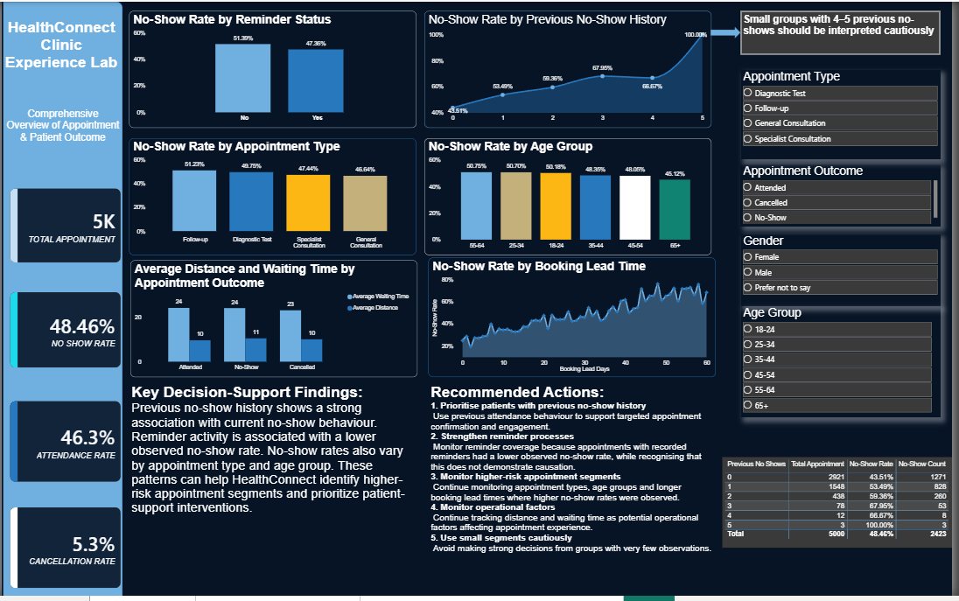
Final Power BI Dashboard
Week 7 refined dashboard used as the final Week 8 analytics dashboard
5

Slide 6
Other Validated Findings
• Reminder status: 51.39% no-show rate without a reminder vs 47.36% when a reminder was recorded.
• Appointment type: Follow-up had the highest observed no-show rate among the analysed appointment types (51.23%).
• Age group: observed no-show rates varied across patient age segments.
• Booking lead time: a broad upward pattern in observed no-show rates appeared at longer lead times.
• Distance and waiting time remain useful operational variables for monitoring.
6

Slide 7
Business Recommendations
• Prioritise patients with previous no-show history for additional confirmation and engagement.
• Strengthen reminder processes and monitor reminder coverage and outcomes.
• Monitor appointment types with relatively higher observed no-show rates.
• Monitor longer booking lead times and consider confirmation closer to appointment dates.
• Continue monitoring patient segments and operational factors such as distance and waiting time.
• Use small segments cautiously and avoid treating observed associations as proof of causation.
7

Slide 8
Business Value
• Provides a clearer evidence base for understanding missed appointments.
• Moves beyond one overall no-show percentage to segment-level monitoring.
• Supports targeted appointment-management and patient-support strategies.
• Provides KPI monitoring through an interactive Power BI dashboard.
• Creates a validated analytics foundation for the wider HealthConnect solution.
8

Slide 9
Limitations & Outstanding Dependency
• The dataset is observational; associations should not be interpreted as causal effects.
• The 4–5 previous no-show groups contain very few observations.
• Distance and waiting-time variables contain limited missing values.
• The analysis identifies patterns but does not independently establish the causes of missed appointments.
• Cross-track feedback was not received during the submission period, so no completed cross-track outcome is claimed.
9

Slide 10
Week 8 Conclusion
• The HealthConnect Data Analytics work progressed from exploratory analysis to validated decision support.
• The final dashboard consolidates KPIs, validated findings, filters, recommendations and supporting evidence.
• Previous no-show history was the strongest observed analytical indicator in the final analysis.
• The output provides a practical foundation for more focused appointment-management decisions.
• Next step: integrate relevant analytics findings into the wider HealthConnect solution and continue validation.
Thank you
10

